Slide 1
Welcome to Leader Dogs for the Blind

Slide 2
Blindness Changes Everything
In the United States
1,300,000
People are legally blind
75,000
People will become blind or visually impaired this year
Notes:
Every year 75,000 people become blind or visually impaired in the United States. When this occurs, people who were independent must now rely on others for assistance.

Slide 3
Staggering Statistics
60%
are unemployed
90%
live in low income settings
43%
live with depression
Notes:
Due to travel limitations, a startling 60% of working age adults who are blind in the United States are unemployed or under-employed. This causes financial hardship and can have negative psychological effects. As a result, 90% live in low income areas.
People with vision loss have a greater risk of health and wellness issues, both mental and physical. 43% live with depression. Many stay at home out of fear which results in social isolation, little physical exercise and family stress.
When someone loses their vision, the impact is far reaching. Family and friends often fear for their loved one’s safety and wellbeing.

Slide 4
Staggering Statistics
10%
Travel Independently
Notes:
What’s more surprising is only 10% of people blind or visually impaired travel independently with a guide dog or white cane.

Slide 5
How Leader dog helps
Notes:
At Leader Dog our mission is to teach people who are blind, visually impaired or Deaf-Blind, to travel independently with a white cane or guide dog. We help our clients regain their sense of independence and confidence. People who were afraid to walk down the sidewalk alone now travel without limits.
After completing orientation and mobility or guide dog training, it is easier for our clients to live a healthy lifestyle. Their newfound confidence and ability for unlimited travel encourages mental and physical wellbeing.
Also impacted is their ability to use mass transit to go to school or get to a job interview. Leader Dog programs position people to join the workforce or advance their career.
When people who are blind can travel safely and independently, the burden of care lifts from family and friends and their peace of mind is restored.
Clients who were isolated before receiving Leader Dog services are now able to actively participate in their communities.
PHOTO DESCRIPTION: Annette Bateman and her second Leader Dog, Stanley (Labrador retriever) - Texas

Slide 6
Leader Dog Programs
Guide Dog Training
Orientation and
Mobility Training
Summer
Experience Camp
Notes:
Founded by three Lions in 1939, Leader Dogs for the Blind has been providing Guide Dog Training from the very start. Recognizing that our client’s needs change throughout their lifetime, we have added Orientation and Mobility Training and a Summer Experience Camp. Now we can serve our clients independent travel needs whether they choose to travel with a white cane or a guide dog. All services are provided free of charge.

Slide 7
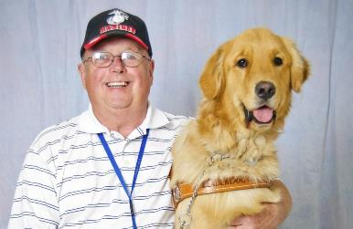
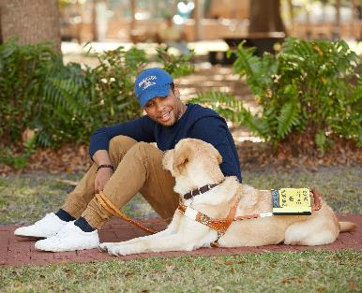
Guide Dog Training
25-day residential program
Deaf-Blind program
Warm weather training
Urban training
Home deliveries
Notes:
Our free, up to 25-day residential program welcomes clients who are legally blind, at least 16 years old, have good orientation and mobility skills and are able to care for a dog.
Training is personalized for each client. Thanks to sophisticated breeding, puppy raising and dog training programs, we are able to match clients with a dog that best fits their lifestyle, travel pace, physical size, stamina and other considerations. Clients have the opportunity to train with their Leader Dog in a wide variety of situations to fit current and future needs, including urban, suburban and rural locations; college campuses; busy stores and malls; public transit and other environments.
We were the first guide dog organization to offer a dedicated program for clients who are both deaf and blind. Leader Dog offers warm weather training in Florida for those who live in warm climates and urban training in Chicago for clients who live or travel in large city environments.
For those who can’t be away from home or work for the extended 25-day training, we offer in-home delivery and will soon be offering “flex” training that is highly tailored to each client’s personal needs.
PHOTO DESCRIPTIONS: (left) Guide Dog Mobility Instructor Jenny Sanderson with Deaf-Blind client Jill Gaus and LD Twinkie (Labrador/golden cross) - Michigan; (top right) Client Bob Justin (Vietnam Veteran - Marine) and LD Lego (golden retriever) - Iowa; (bottom right) Client Gui (pronounced “Gee”) and LD Emma (Labrador/golden cross) - Florida

Slide 8
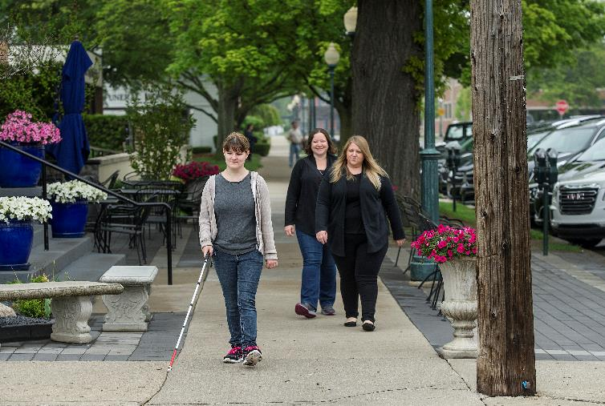
Orientation and Mobility Training
How to use a white cane
5-day training
Where I am
Where I want to go
Notes:
Our free orientation and mobility (O&M) training is learning how to use a white cane to effectively know where you are, where you want to go and the skills to get safely to your destination.
Orientation and Mobility Training is a one-week residential program. Our clients stay on our campus and training takes place in a wide variety of environments, such as residential, semi-business, business, city and rural settings. The majority of instruction takes place outdoors with some indoor training focused on how to navigate elevators, escalators and moving sidewalks.
Our O&M training provides individuals with white cane skills in a much shorter time frame than traditional O&M programs. The one-on-one instruction is tailored to each client’s capabilities, allowing individual needs to be met.
During training, skills learned may include:
Utilizing a human guide
Using cardinal directions (i.e., north, south, east, west) to know where you are, where you want to go and how to get there
Solving problems along your route, such as barriers, crowds, etc.
Crossing streets
Re-orientating yourself when you get lost
Shopping, soliciting assistance when needed, and more
O&M Training is provided to people who are legally blind and at least 16 years of age, regardless of whether or not they plan to train with a Leader Dog. Classes are ongoing throughout the year.
PHOTO DESCRIPTION: Client Shyanne Racey of Virginia learns the proper use of a white cane during Orientation and Mobility Training in Downtown Rochester. Certified O&M Specialist Maggie Winn (blond) follows closely behind. Shyanne also attended Summer Experience Camp and was a camp counselor the following year.

Slide 9
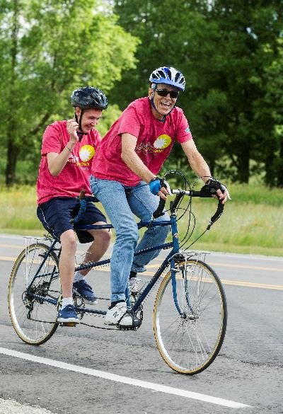
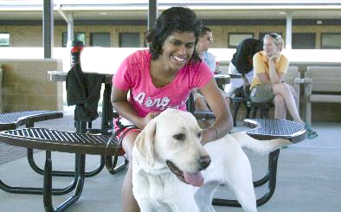
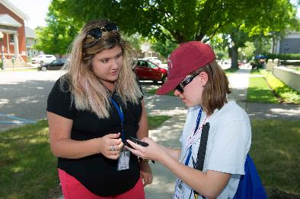
Summer Experience Camp
16-17 years old
Leadership training
Learn about Leader Dogs
GPS training/equipment
Notes:
Our free Summer Experience Camp is a unique opportunity for teenagers who are 16 and 17 and are legally blind. To help them transition to the next stage of their lives, we offer leadership development, an introduction to guide dogs, and the opportunity to spend time with peers. Campers receive free GPS devices and learn how to use them in a variety of environments including on a college campus. Campers also experience tandem biking, beep kickball, rock wall climbing and more traditional camp fun.
Summer Experience Camp will be held Saturday, June 22–Saturday, June 29, 2019. Deadline for applications is March 31, 2019.
PHOTO DESCRIPTIONS: (left) For many campers this is their first experience at riding on a bicycle; (top right) Getting to meet, walk with and learn about guide dogs is a major bonus of our camp; (bottom right) A camper is coached on how to use a GPS device to navigate in new and unknown environments. Near the end of camp, the kids show off their GPS skills with a scavenger hunt.

Slide 10
The leader dog impact

Slide 11
Every Year, Lions + Leader Dog =
1,095,000
Days of independence
200
Leader Dogs matched with clients
100
Clients provided with white cane training
24
Teenagers who gain leadership and travel skills
6
Customized guide dog training for clients who are Deaf-Blind
$0
Cost passed on
to our clients
Notes:
Days of independence equals the current number of active guide dog clients plus the number of O&M clients and campers we have served times 365 days in a year.

Slide 12
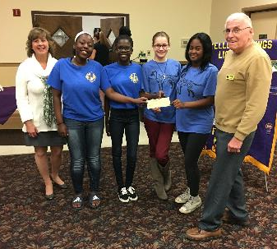
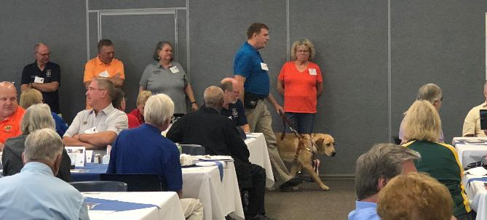
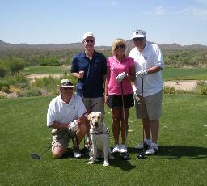
How Your Club and District Can Help
Talk about Leader Dog with your family and friends. Post brochures around town!
Encourage people to donate to support the mission
Post about Leader Dog on your social media account or share ours. Leader Dog is on Facebook, Twitter, Instagram and Linked In – so follow us!
Host a fundraising event
Invite people to LeaderDog.org – success stories, applications and more on available
Notes:
Talk about Leader Dog with your family and friends. Post brochures around town!
Encourage people to donate to support the mission
Post about Leader Dog on your social media account or share ours. Leader Dog is on Facebook, Twitter, Instagram and Linked In – so follow us!
Host a fundraising event
Invite people to LeaderDog.org – success stories, applications and more on available
PHOTO DESCRIPTIONS: (left) Members of the Walkersville Leo Club (Maryland MD-22) show off their $11,718.97 donation to Leader Dog at a local Lions meeting. They are the first Leo club to attain LDB Top Dog status.; (center) Client and Lion BJ Blahnik and LD Goober (Labrador retriever) give a working demonstration to a group of Lions visiting Leader Dog. BJ is from Wisconsin.; (right) Golf outings are great fundraisers.

Slide 13
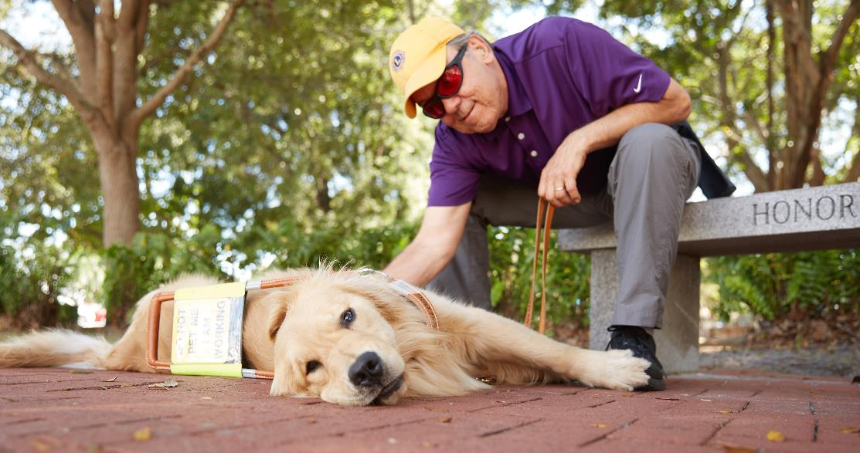
In Every Leader Dog Lies the Heart of a Lion
Together Leader Dog and Lions
make people unstoppable.
Notes:
Together Leader Dog and Lions make people unstoppable. Thank you for support!
“In every Leader Dog lies the heart of a Lion.”
-PDG and Leader Dog client Len Quinn
PHOTO DESCRIPTION: Client and Lion Bill Graham and Leader Dog Gibson (golden retriever) relax during warm weather training in Naples, Florida. Lion Bill is from North Carolina.

